Slide 1

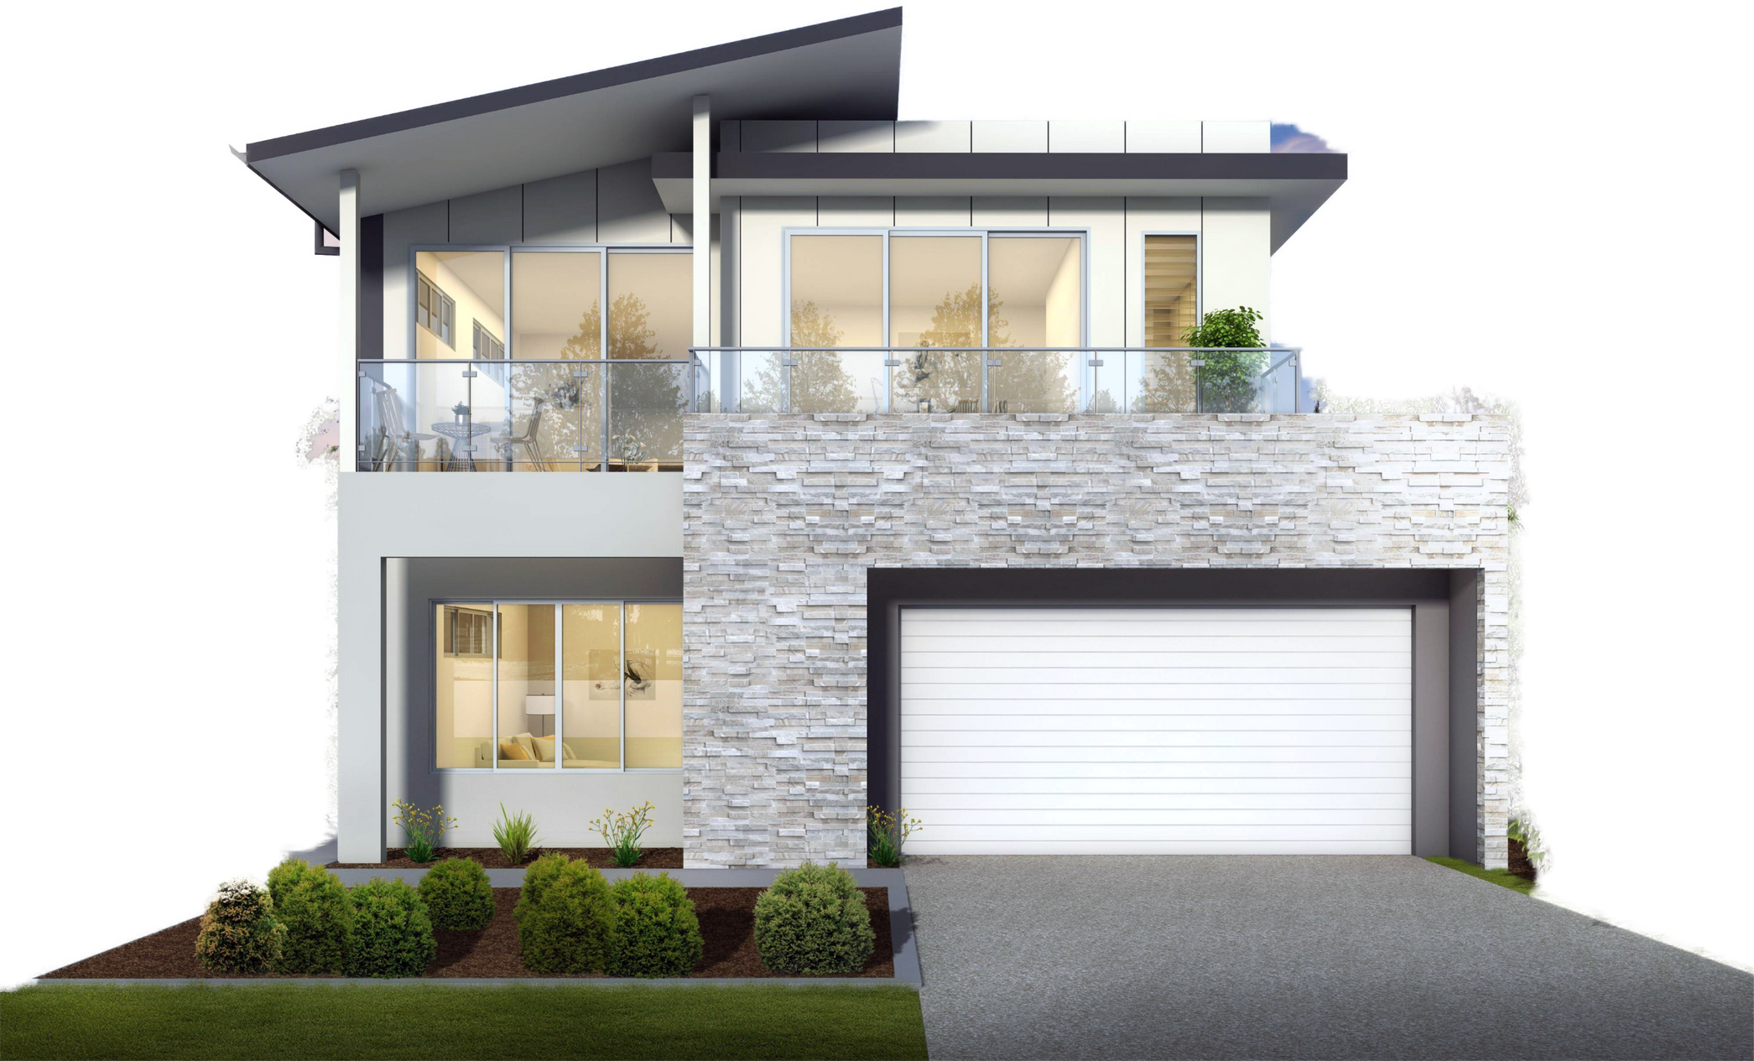
SOCAL HOUSE PRICE ESTIMATOR
HYBRID MACHINE LEARNING MODEL TABULAR DATA + IMAGES
Javier García Esteve

Slide 2
PROJECT MOTIVATION
Why Tabular Data Isn’t Enough
Price depends on numeric factors (bedrooms, bathrooms, sqft…)
Location
But also on visual factors, such as:
Condition & maintenance level
Architectural style
Landscaping & curb appeal
Overall quality
Limitation of Tabular Models
Tabular models capture structural attributes
But they are blind to how the property actually looks
Goal
Combine both worlds:
Structured tabular data
Automatically extracted visual information from house images
→ A richer, more realistic home-price prediction model

Slide 3

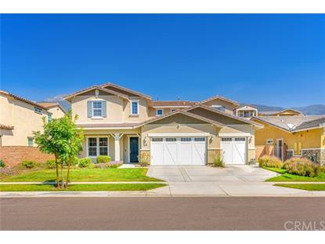
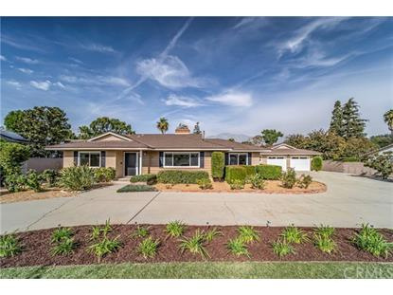
DATASET OVERVIEW
15,474 Southern California listings, each with:
Tabular metadata:
Bedrooms · Bathrooms · Sqft · City · Address · Price
Target variable: price
Property image
EDA insights:
Price highly skewed → log transform
City dominates price variation → need good encoding

Slide 4
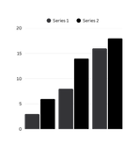
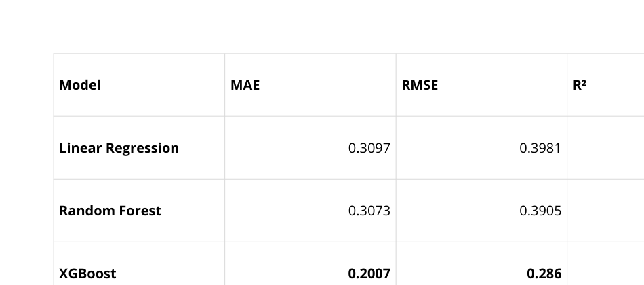
TABULAR MODELING (BASELINES)

Slide 5
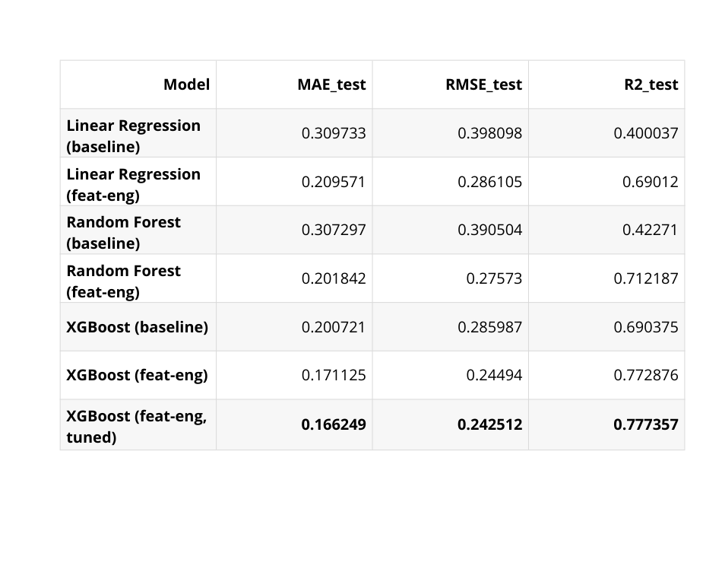
FEATURE ENGINEERING & HYPERPARAMETER TUNING
Created features that reflect real estate logic:
sqft_per_bed
sqft_per_bath
log_sqft
total_rooms
city_target_enc (mean log-price per city)
Feature importance shows:
City encoding = strongest factor
Size metrics = next strongest
Spaciousness features add extra lift
Hyperparameter Tuning
Gridsearch
Result:
XGBoost + FE + tuning improved to R² = 0.78

Slide 6



WHY INCORPORATE IMAGES?
Tabular data misses key visual factors:
Renovation quality
Architectural style
Condition
Landscaping
Curb appeal
Luxury finishes
Neighborhood visual cues
Users often can’t provide this information manually.
Even homeowners may not know or can't objectively describe these attributes.
But everyone can take a picture!
An image can capture many of these visual signals instantly.
Solution:
let the model learn these visual cues automatically from images.

Slide 7
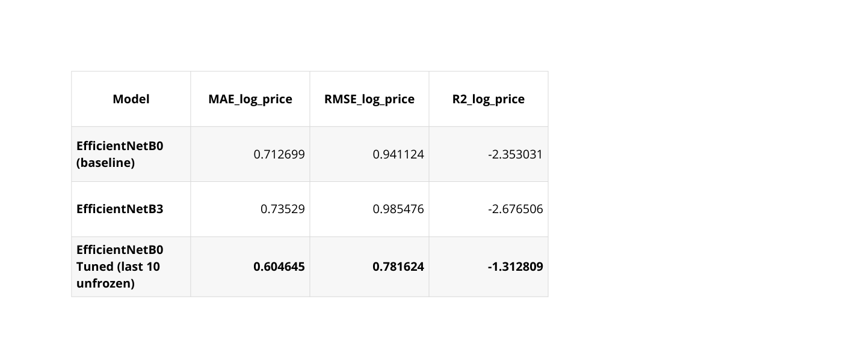
CNN MODEL ARCHITECTURE
Transfer Learning: EfficientNetB0 tuned
MODELS TESTED
EfficientNet backbone
Unfreeze last 10 layers
Lower learning rate
Strong augmentations (flip, zoom, rotation, contrast)
Added head:
GlobalAveragePooling
Dense layer(128) → embedding
Dropout 0.3
Dense layer(1) → log-price output
CNN models performed poorly for standalone price prediction.
The 128-dim embedding is the valuable output — used as visual features inside the hybrid model.
Texto
Texto

Slide 8
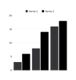
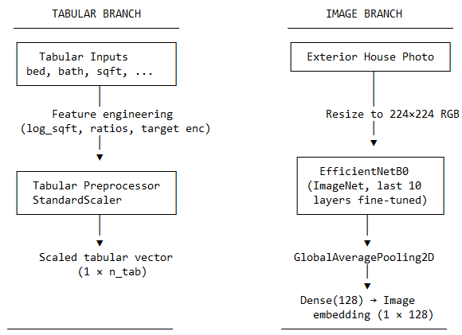
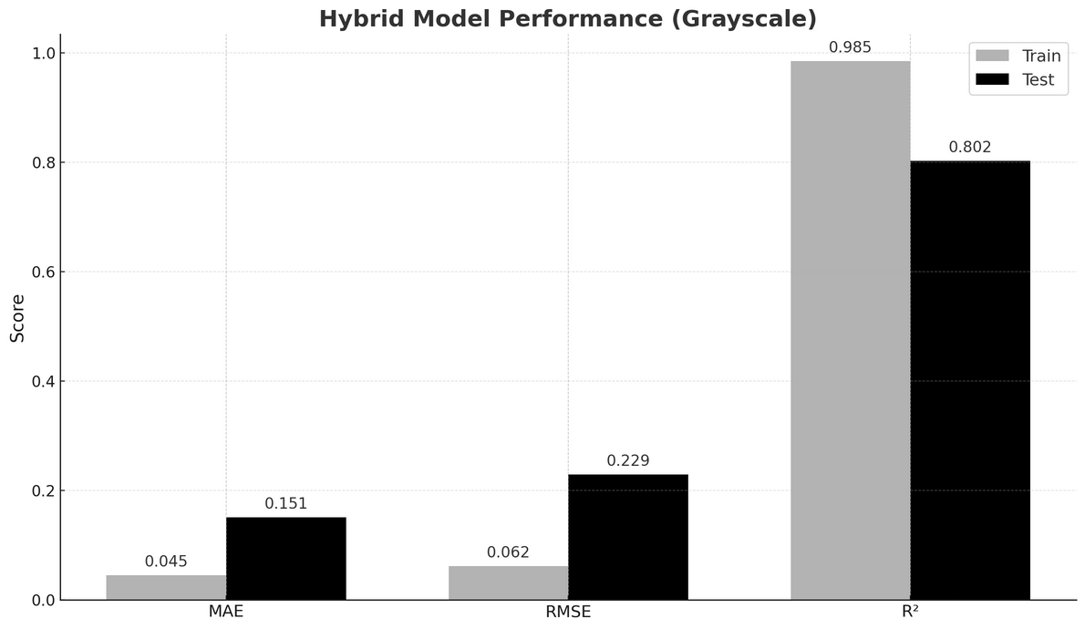
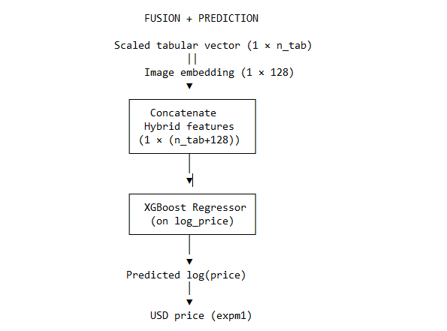
HYBRID MODEL
HYBRID ARCHITECTURE DIAGRAM
Hybrid = Tabular Features + Image Embedding → XGBoost
Steps:
Scale tabular features
Extract 128-dim embedding from EfficientNetB0 (fine-tuned)
Combine tabular features + image embedding into one vector
Feed this hybrid vector into XGBoost regressor
Predict log(price) → convert back to USD
Performance:
Hybrid Model: R² = 0.80

Slide 9
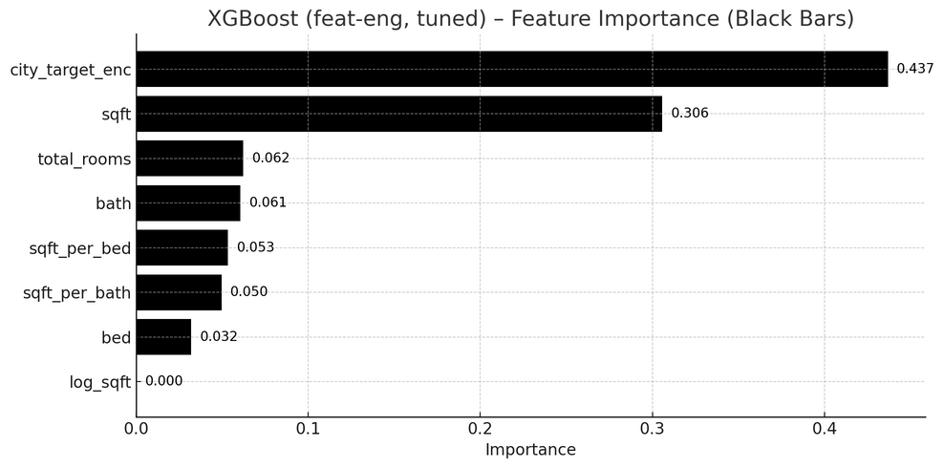
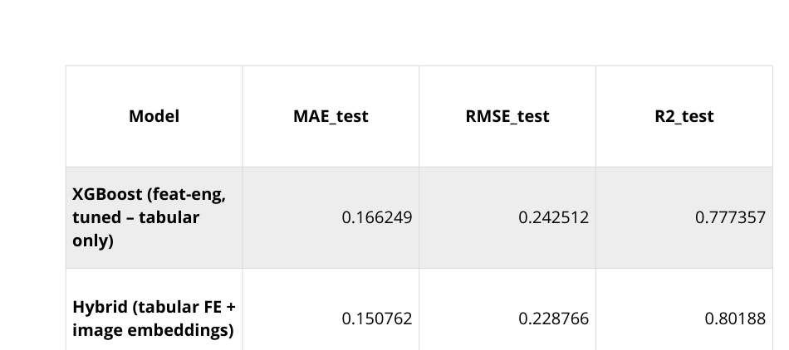
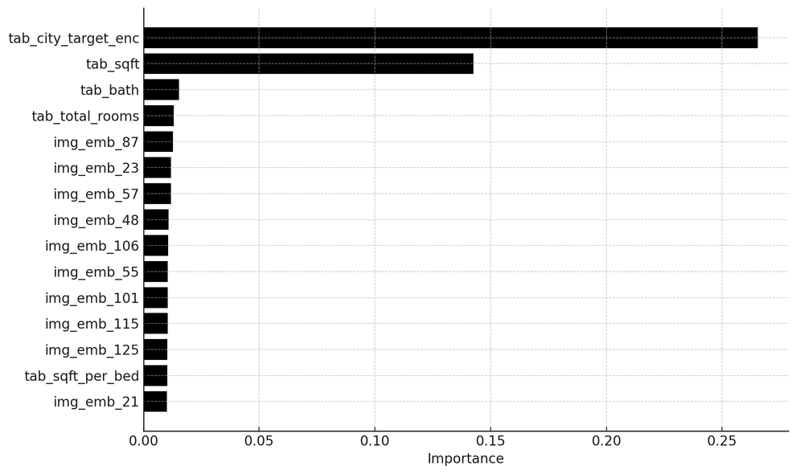
TABULAR-ONLY
VS
HYBRID MODEL
XGBoost (feat-eng, tuned) – Feature Importance
Hybrid XGBoost – Top 15 Features

Slide 10
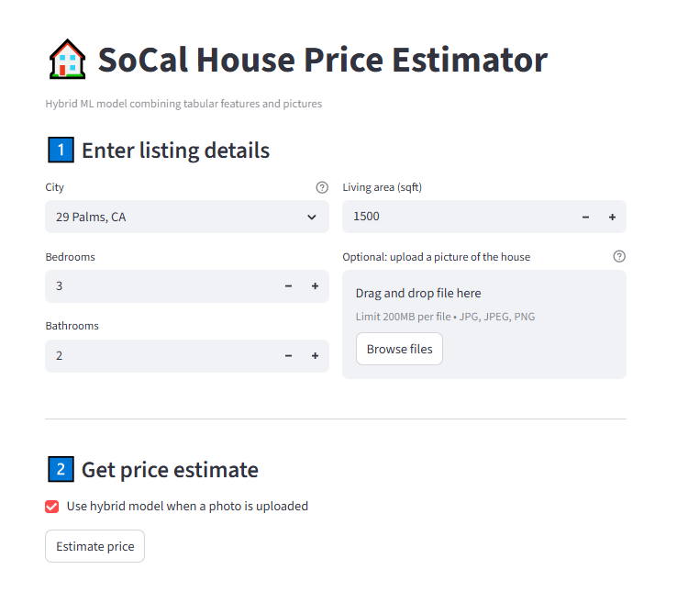
DEMO
“To make this accessible, I built a Streamlit app where the user inputs the property details and optionally uploads an image.
If an image is provided you can choose to either run the hybrid model or just the tabular one. If you don’t provide an image, just the tabular-only model runs.”

Slide 11
CONCLUSION & FUTURE WORK
Key Conclusions
Feature engineering significantly boosts performance
CNN embeddings add visual intelligence
Hybrid model is the global best performer
Real-time app demonstrates practical application
Future Ideas
Add Interior pictures
Multiple images per listing
Satellite imagery
Multi-task models (price + condition scoring)

Slide 12
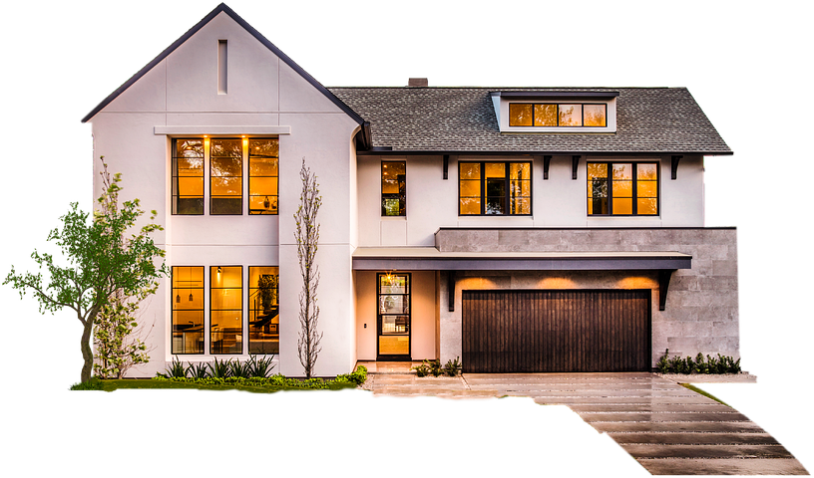
THANK YOU!

